Slide 1
INTRODUCTION TO DATA ANALYSIS USING EXCEL
UNIT - I
INTRODUCTION TO DATA SCIENCE

Slide 2
Data Analysis
Data Analysis is the process of examining, cleaning, transforming, and modeling data to discover useful information, patterns, and trends to support decision-making.
The main aim of data analysis is turning raw data into useful information.
Data Analysis process involves setting goals, collecting the data, cleaning, Interpreting the results in context.
Data collection is gathering the data from relevant sources.
Data cleaning is removing errors, handling missing values.
Interpreting the results in context means going beyond the numbers to explain why the results occurred and what they mean in the real world, considering all relevant factors.
Data analysis is at the heart of modern decision-making.
Data Analysis is about understanding past and present data to make informed decisions.
Data Science is about using data to create systems that can predict, learn, and automate decisions.

Slide 3
Comparison: Data Analysis vs Data Science
Aspect | Data Analysis | Data Science
Definition | Examining data to find patterns and insights | A broad field involving extraction of knowledge and predictions from data
Primary Goal | To understand and interpret existing data | To build models, make predictions, and automate decision-making
Focus | What happened and why | What will happen or what to do next
Type of Data | Structured data (e.g., tables, spreadsheets) | Structured + Unstructured data (e.g., text, images, audio)
Processes Involved | Data cleaning, summarization, visualization | Data collection, cleaning, modeling, machine learning, deployment
Tools Used | Excel, SQL, Python (Pandas, Matplotlib), Tableau | Python (Scikit-learn, TensorFlow), R, Spark, Big Data tools
Techniques | Descriptive statistics, charts, pivot tables | Machine learning, statistical modeling, AI
Outcome | Reports, dashboards, summaries | Predictive models, intelligent systems
Skill Level | Generally easier to learn; foundation for Data Science | Requires deeper knowledge of programming, statistics, and ML
Typical Roles | Data Analyst, Business Analyst | Data Scientist, ML Engineer, AI Specialist

Slide 4
Types of Data Analysis
Data Mining
Business Intelligence
Statistical Analysis
Predictive Analytics
Text Analytics

Slide 5
Data Mining
Data Mining is the process of analyzing large datasets to find hidden patterns, relationships, and useful information.
The goal is to extract knowledge, not data — it focuses on discovering meaningful patterns that were not previously known.
It is a key step in the Knowledge Discovery in Databases (KDD) process.
Data mining analysis involves computer science methods at the intersection of the artificial intelligence, machine learning, statistics, and database systems.
The patterns found through data mining can help in Summarizing data, Improving decision-making, Making accurate predictions.
It is widely used in decision support systems to assist businesses in planning and forecasting.

Slide 6
Applications of Data Mining include customer profiling and segmentation, market basket analysis, fraud and anomaly detection, predictive modeling.
It is used across multiple industries such as finance, healthcare, retail, and telecommunications.
The results of data mining can uncover actionable insights, improve the accuracy of predictions, be integrated into decision support systems, detect outliers or anomalies.

Slide 7
Business Intelligence
Business Intelligence techniques and tools are for acquisition and transformation of large amounts of unstructured business data to help identify, develop and create new strategic business opportunities.
The goal of business intelligence is to allow easy interpretation of large volumes of data to identify new opportunities. It helps in implementing an effective strategy based on insights that can provide businesses with a competitive market-advantage and long-term stability.
Why are sales dropping in this region? Where do we have excess inventory? What are customers saying on social media? BI helps answer these critical questions.
“Business intelligence provides past and current insights into the business,” says Maamar Ferkoun in his IBM cloud computing and business intelligence blog.

Slide 8
Retailers, for example, can increase cost savings by comparing performance and benchmarks across stores, channels, and regions. And, with visibility into the claims process, insurers can see where they are missing service targets and use that information to improve outcomes.

Slide 9
Statistical Analysis
Statistics is the study of collection, analysis, interpretation, presentation, and organization of data.
In data analysis, two main statistical methodologies are used-
Descriptive statistics: In descriptive statistics, data from the entire population or a sample is summarized with numerical descriptors such as - Mean, Standard Deviation for Continuous Data; Frequency, Percentage for Categorical Data
Inferential statistics: It uses patterns in the sample data to draw inferences about the represented population or accounting for randomness. These inferences can be
answering yes/no questions about the data (hypothesis testing)
estimating numerical characteristics of the data (estimation)
describing associations within the data (correlation)
modeling relationships within the data (E.g. regression analysis)

Slide 10
Predictive Analytics
Predictive analytics is the process of using data to forecast future outcomes.
The process uses data analysis, machine learning, artificial intelligence, and statistical models to find patterns that might predict future behavior.
Organizations can use historic and current data to forecast trends and behaviors seconds, days, or years into the future with a great deal of precision.
In general, there are two types of predictive analytics models: classification and regression models.
Classification models attempt to put data objects (such as customers or potential outcomes) into one category or another. For instance, if a retailer has a lot of data on different types of customers, they may try to predict what types of customers will be receptive to market emails.
Regression models try to predict continuous data, such as how much revenue that customer will generate during their relationship with the company.

Slide 11
Text Analytics
Text analytics is the process of transforming unstructured text documents into usable, structured data. Text analysis works by breaking apart sentences and phrases into their components, and then evaluating each part’s role and meaning using complex software rules and machine learning algorithms.
Text analytics forms the foundation of numerous natural language processing (NLP) features, including named entity recognition, categorization, and sentiment analysis.
Text Analytics, also referred to as Text Mining or as Text Data Mining is the process of deriving high-quality information from text.

Slide 12
Data Analysis Process
Specification of Data Requirements
Data Gathering
Data Processing
Data Cleaning
Data Analysis
Data Communication

Slide 13
Specification of Data Requirements
Identify the business question you’d like to answer. What problem is the company trying to solve? What do you need to measure, and how will you measure it?
Figure out what data is needed based on their requirements or questions.
If we want to study a group of people (called a population).
Specific variables regarding a population (e.g., Age and Income) may be specified and obtained.
Data may be numerical or categorical.

Slide 14
Data Gathering
It means collecting the raw information (data) you need to answer a specific question or solve a problem.
To gather the specific variables or details identified in the earlier step.
Data can be collected from:
Internal sources (inside your organization)
→ e.g., CRM software, employee records, sales data
External sources (outside your organization)
→ e.g., Government websites, online surveys, social media APIs, web pages
Often, the data is:
Unstructured
May include irrelevant information
The collected data is required to be subjected to Data Processing and Data Cleaning.

Slide 15
Data Processing and Data Cleaning
The data that is collected must be processed or organized for analysis. This includes structuring the data as required for the relevant Analysis Tools. For example, the data might have to be placed into rows and columns in a table within a Spreadsheet or Statistical Application. A Data Model might have to be created.
Clean the data to prepare it for analysis. This often involves purging duplicate and anomalous data, reconciling inconsistencies, standardizing data structure and format, and dealing with white spaces and other syntax errors.
For example: In financial data, check if the totals match known or published values. It helps spot mistakes or fraud.
Quantitative data methods can be used for outlier detection that would be subsequently excluded in analysis.

Slide 16
Data Analysis
By manipulating the data using various data analysis techniques and tools, you can find trends, correlations, outliers, and variations that tell a story. During this stage, you might use data mining to discover patterns within databases or data visualization software to help transform data into an easy-to-understand graphical format.
Data Visualization may also be used to examine the data in graphical format, to obtain additional insight regarding the messages within the data.
Statistical Data Models such as Correlation, Regression Analysis can be used to identify the relations among the data variables.

Slide 17
Data Communication
The results of the data analysis are to be reported in a format as required by the users to support their decisions and further action. The feedback from the users might result in additional analysis.
The data analysts can choose data visualization techniques, such as tables and charts, which help in communicating the message clearly and efficiently to the users.
Interpret the results of your analysis to see how well the data answered your original question. What recommendations can you make based on the data?

Slide 18
Data Analysis with Excel
Microsoft Excel is a powerful electronic spreadsheet program you can use to automate accounting work, organize data, and perform a wide variety of tasks. Excel is designed to perform calculations, analyze information, and visualize data in a spreadsheet. Also this application includes database and charting features.

Slide 19
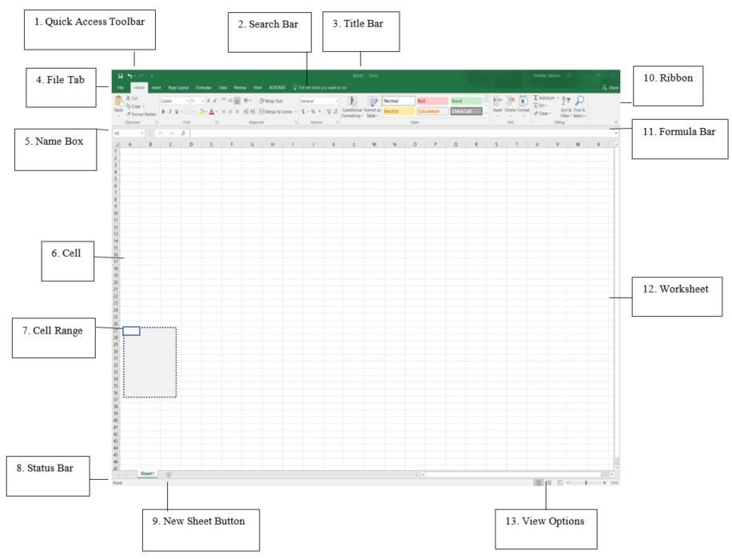

Slide 20
Spreadsheet Terms
 | Term | Description
1 | Quick Access Toolbar | Displays quick access to commonly used commands.
2 | Search Bar | Advance search will help you find and perform tasks.
3 | Title Bar | Displays the name of the application file.
4 | File Tab | The File tab has replaced the Office button. It helps you to manage the Microsoft application and provide access to its options such as Open, New, Save, As Print, etc.
5 | Name Box | Displays the active cell location.
6 | Cell | The intersection of a row and column; cells are always named with the column letter followed by the row number (e.g. A1 and AB209); cells may contain text, numbers and formulas.
7 | Range | One or more adjacent cells. A range is identified by its first and last cell address, separated by a colon. Example ranges are B5:B8, A1:B1 and A1:G240.
8 | Status Bar | Displays information about the current worksheet.
9 | New Sheet | Add a new sheet button.
10 | Ribbon | Displays groups of related commands within tabs. Each tab provides buttons for commands.
11 | Formula Bar | Input formulas and perform calculations.
12 | Worksheet | A grid of cells that are more than 16,000 columns wide (A-Z, AA-AZ, BA-BZ…IV) and more than 1,000,000 rows long.
13 | View Option | Display worksheet view mode.

Slide 21
Ribbons
Microsoft Excel ribbon is the row of tabs and icons at the top of the Excel window that allows you to quickly find, understand and use commands for completing a certain task.
The ribbon first appeared in Excel 2007 replacing the traditional toolbars and pull-down menus found in previous versions. In Excel 2010, Microsoft added the ability to personalize the ribbon.
The ribbon in Excel is made up of four basic components: tabs, groups, dialog launchers, and command buttons.
Ribbon tab contains multiple commands logically sub-divided into groups.
Ribbon group is a set of closely related commands normally performed as part of a larger task.
Dialog launcher is a small arrow in the lower-right corner of a group that brings up more related commands. Dialog launchers appear in groups that contain more commands than available space.
Command button is the button you click to perform a particular action

Slide 22
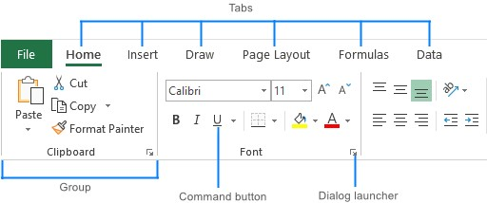

Slide 23
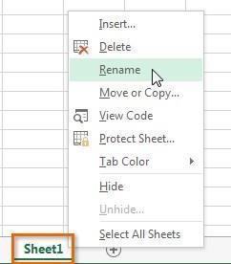
Rename a Worksheet
Every workbook contains at least one worksheet by default. When working with a large amount of data, you can create multiple worksheets to help organize your workbook and make it easier to find content. You can also group worksheets to quickly add information to multiple worksheets at the same time.

Slide 24
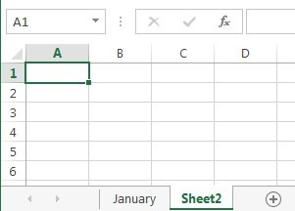
Insert a New Worksheet

Slide 25
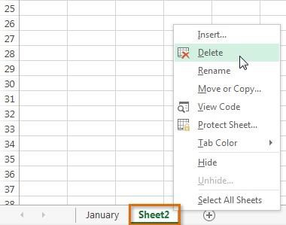
Delete a Worksheet

Slide 26
Copy/Move Worksheet
You can copy worksheets to other workbooks as required. For example, you might need to keep records for six different divisions – rather than send each division the entire set of records, you can copy their worksheet to another workbook and send them their data only.
If worksheets exist in the other workbook, you will need to determine the order in which to place the copied worksheet.

Slide 27
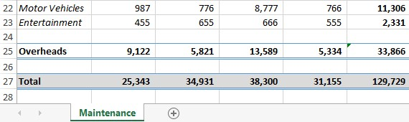
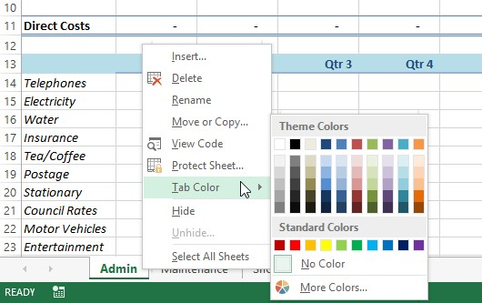
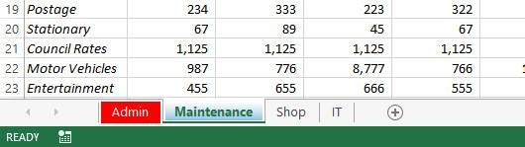
CHANGING WORKSHEET TAB COLOURS

Slide 28
Range
A range in Excel refers to a group of one or more selected cells in a worksheet. Ranges can be horizontal, vertical, or rectangular (rows × columns).
Relative ,Absolute and Mixed Cell Addresses
As you move and copy formulas, Excel automatically adjusts the part of the cell reference in the formula that changes as you move down or to the right. For example, when you copy a formula from a cell to columns to the right, Excel changes the column letters in the formula without touching the row numbers. Excel assumes that everything is relative addressing; that is, relocated and copied formulas will reference information according to the number of columns and rows they have moved(e.g. =A1+B1 copied to next row becomes =A2+B2).
There are situations where automatic adjustment of the cell references does not calculate correctly. This is especially true with percentage formulas where the denominator should remain constant. A dollar sign ($) placed before the column letter and row number (e.g. $B$6) will lock the address or make it absolute addressing.
Either row or column is fixed this is referred as mixed addressing
(e.g. =$A1 → Column fixed, row changes, =A$1 → Row fixed, column changes).

Slide 29
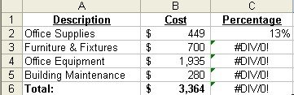
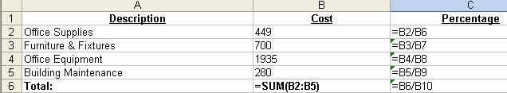
Click in cell C2, and then type =B2/B6 to create a formula to calculate the percentage of Office Supplies costs out of the total cost. Auto Fill this formula down through the cell range C3:C6. The sheet should appear as shown above. Notice the errors in cells C3:C6.
Click on each cell individually to read the formula in the formula bar. The reason that the copied formula resulted in errors is that Excel copied this formula assuming relative references for each formula (adjusting the denominator in each cell). Make sure that formulas are not displaying.

Slide 30
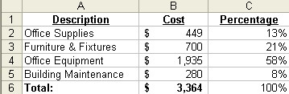
Click in cell C2, and then type =B2/$B$6 to create the formula to calculate the percentage again. The $ sign locks the address or make it absolute. Auto Fill this formula down through the cell range C3:C6.

Slide 31
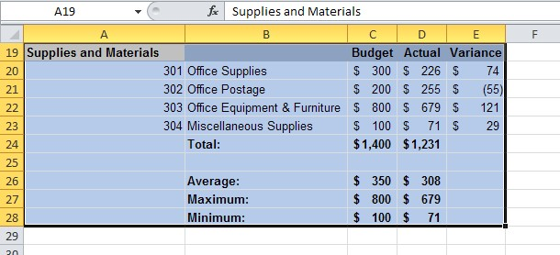
RANGE NAMES
Named Ranges
When cell or range names become tedious to memorize in a spreadsheet, use the Named Ranges feature. Named Ranges provide a word method of referring to cell addresses. For example, you may frequently need to print a range that is difficult to type or remember. Use the Name Box to create a name for a range.

Slide 32
Type your desired name, example: Supply and press the Enter key.
Select a cell anywhere on spreadsheet.
Click on the Name box drop down arrow, the name you entered will appear on a menu list. Select your desired name and the cell range associated with the name will appear.
Guidelines for naming ranges
The first character of a name must be a letter or an underscore character. Remaining characters in the name can be letters, numbers, periods, and underscore characters.
Names cannot be the same as a cell reference, such as FY99, Z$100 or R1C1.
Spaces are not allowed. Underscore characters and periods may be used as word separators; for example, First.Quarter or Sales_Tax.
A name can contain up to 255 characters.
Names are not case sensitive in Excel. For example, if you have created the name Sales and then create another name called SALES in the same workbook, the second name will replace the first one.

Slide 33
RANGE NAMES (Another Approach)
You can define names for often-used formulas. The formula doesn’t physically have to appear in a cell.
This not only saves memory but often makes your worksheets easier to read. Follow these steps to name a formula:
Select Formulas > Define Name to display the New Name dialog box.
Enter the name you want to use for the formula in the Name text box.
In the Refers To box, enter the formula exactly as you would if you were entering it in a worksheet.
Select OK
Now you can enter the formula name in your worksheet cells (instead of the formula itself). For example, the following is the formula for the volume of a sphere (r is the radius of the sphere): 4πr3/3

Slide 34
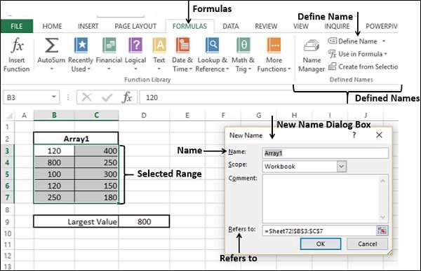
So, assuming that you have a cell named Radius somewhere in the workbook, you could create a formula named, say, Sphere Volume. Then you could make the following entry in the Refers To box of the New Name dialog box (where PI is the Excel worksheet function that returns the value of pi): =4 * PI() * Radius ^ 3 / 3

Slide 35
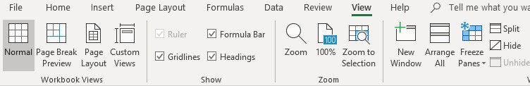
Freeze Panes
Freeze Panes is an Excel feature that allows you to keep row or column titles on the screen while you scroll through long lists on a worksheet. Freezing panes on a worksheet does not affect printing.
To freeze panes, click the cell where you want to freeze the rows and/or columns (to the immediate right of the desired column and/or below the desired row).
Select the View tab, click on the drop-down arrow next to the Freeze Panes button, and then select the Freeze Panes option.
To remove these panes, Select the View tab, click on the drop-down arrow next To the Freeze Panes button, and then select the Unfreeze Panes option.

Slide 36
Table
A Table is a rectangular range of structured data.
The key features are
Each row in the table corresponds to a single record of the data. Example Employee information.
Each column contains a specific piece of information. Example- The columns can contain data such as name, employee number, hire date, salary, department, etc. The top row describes the information contained in each column and is referred to as header row.
Each entry in the top row is referred to as column header.
Select the Range of Cells that you want to include in the Table.

Slide 37
Difference between Tables and Ranges
A table is a more structured way of working with data than a range. You can convert a range into a table.
Excel provides table tools in the ribbon ranging from properties to styles.
Excel automatically provides a Filter button in each column header to sort the data or filter the table such that only rows that meet your defined criteria are displayed.
If you have multiple rows in a table, and you scroll down the sheet so that the header row disappears, the column letters in the worksheet are replaced by the table headers.
When you place a formula in any cell in a column of the table, it gets propagated to all the cells in that column.

Slide 38
You can use table name and column header names in the formulas, without having to use cell references or creating range names.
You can extend the table size by adding more rows or more columns by clicking and dragging the small triangular control at the lower-right corner of the lower-right cell.
You can create and use slicers for a table for filtering data.

Slide 39
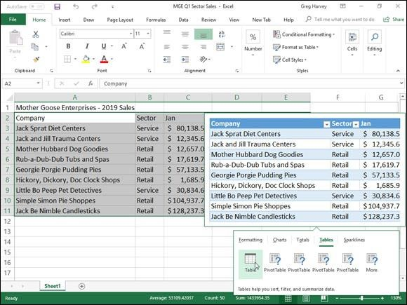
Formatting Tables with the Quick Analysis Tool
Click the Tables tab in the Quick Analysis tool’s option palette to display its Table and Pivot Table buttons. When you highlight the Table button on the Tables tab, Excel’s Live Preview shows you how the selected data will appear formatted as a table.
To apply this previewed formatting and format the selected cell range as a table, you have only to click the Table button.

Slide 40
Understanding formula basics
All Excel formulas have the same general structure: an equal sign (=) followed by one or more operands—which can be values, cell references, ranges, range names, or function names—separated by one or more operators—which are symbols that combine the operands in some way, such as the plus sign (+) and the greater-than sign (>).
Entering a new formula into a worksheet appears to be a straightforward process:
Select the cell in which you want to enter the formula.
Type an equal sign (=) to tell Excel that you’re entering a formula.
Type the formula’s operands and operators.
Select Enter to confirm the formula.

Slide 41
=10+5 Result is 15 //arithmetic
=10=5 Result is FALSE //comparison
Using reference formulas- The reference operators combine two cell references or ranges to create a single joint reference.
Reference formula operators
Operator Name Description
: (colon) Range Produces a range from two cell references (for example, A1:C5).
(space) B2:E8) Intersection Produces a range that is the intersection of two ranges (for example, A1:C5
, (comma) Union Produces a range that is the union of two ranges (for example, A1:C5,B2:E8).
The power of formulas comes from using cell references (similar to variable names in programming).
Cell reference examples:
= A1 + A2
= B1 + A3 - A4

Slide 42
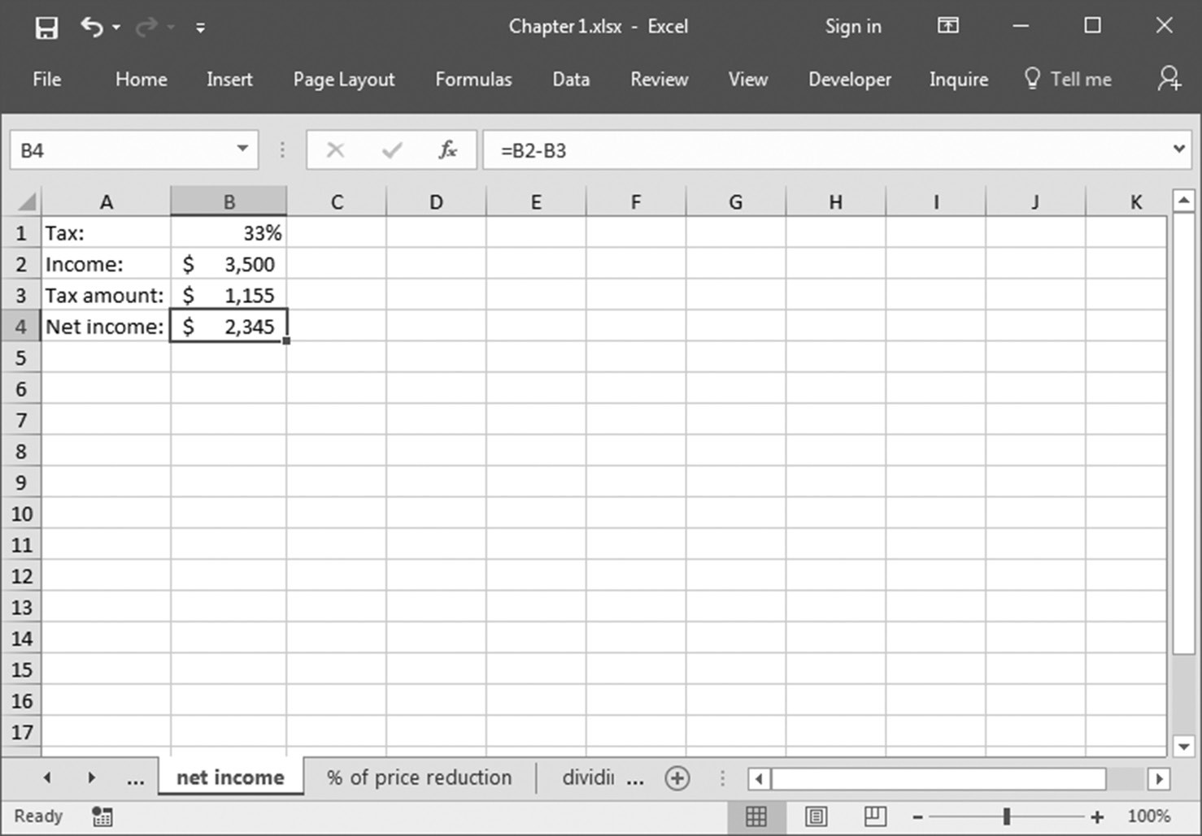
Calculate your net income
To calculate net income, it is necessary to consider the tax percentage, using the following calculation.
Select cell B1 and enter the tax as a percentage: 33%.
In cell B2, enter the gross income: $3500.
Select cell B3 and type the formula =B2*B1 to calculate the tax amount.
Determine the net income in cell B4 with the formula =B2-B3.

Slide 43
Using Excel Functions
Excel has a large number of built‐in functions to use.
A function takes arguments as input and produces an output.
Arithmetic, Statistical and Logical Functions.
Arithmetic- SUM(number1, number2, ... Or range), SUMIF(range, criteria, sum_range), SUMPRODUCT, ROUND, PRODUCT, POWER, GCD, LCM, SUMIFS, SUMSQ,……(Math and trigonometry functions)
In cells A2:A11, enter the different phases.
Enter the cost of each phase in cells B2:B11.
In cell D1, enter 1000 as the given criterion.
Select cell D2 and type the following formula: =SUMIF(B2:B11,">" & D1).
Press <Enter>.

Slide 44
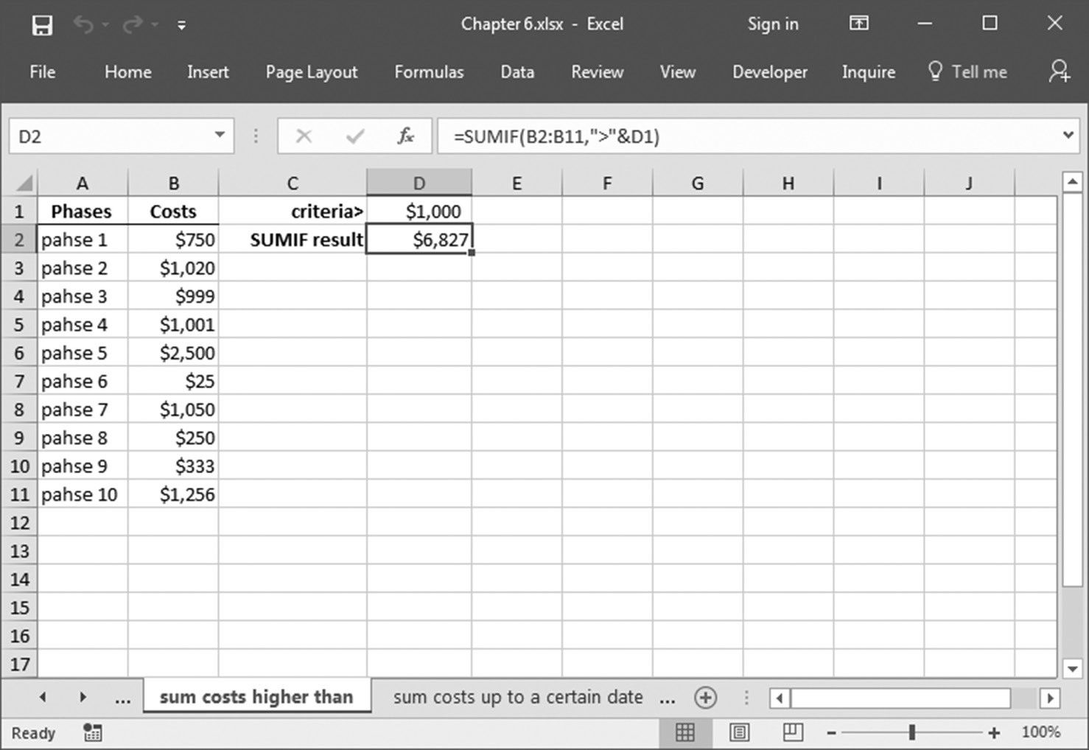

Slide 45
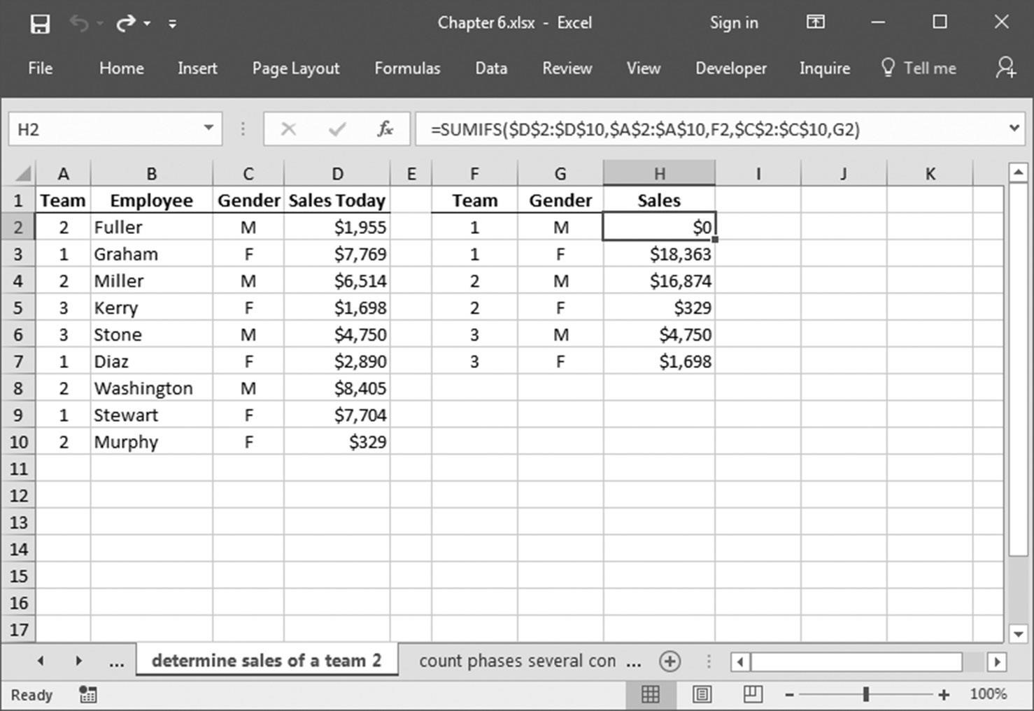
The table not only sums the sales of different teams but also sums the sales of each team by the gender of each member.

Slide 46
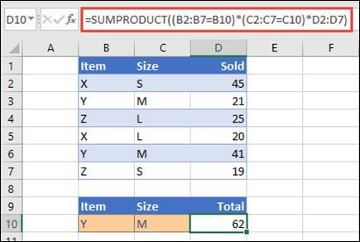
SUMPRODUCT function
The SUMPRODUCT function returns the sum of the products of corresponding ranges or arrays. The default operation is multiplication, but addition, subtraction, and division are also possible.
In this example, we'll use SUMPRODUCT to return the total sales for a given item and size:
SUMPRODUCT matches all instances of Item Y/Size M and sums them, so for this example 21 plus 41 equals 62.
To perform other arithmetic operations
Use SUMPRODUCT as usual, but replace the commas separating the array arguments with the arithmetic operators you want (*, /, +,-). After all the operations are performed, the results are summed as usual.

Slide 47
Statistical Functions
COUNT function
The COUNT function is used to count the number of cells containing a number. Always remember one thing that it will only count the number.
Formula for COUNT function = COUNT(value1, [value2], …)
2. COUNTA function
This function will count everything, it will count the number of the cell containing any kind of information, including numbers, error values, empty text.
Formula for COUNTA function = COUNTA(value1, [value2], …)
COUNTBLANK function
COUNTBLANK function, as the term, suggest it will only count blank or empty cells.
Formula for COUNTBLANK function = COUNTBLANK(range)

Slide 48
COUNTIFS function
COUNTIFS function is the most used function in Excel. The function will work on one or more than one condition in a given range and counts the cell that meets the condition.
Formula for COUNTIFS function = COUNTIFS (range1, criteria1, [range2], [criteria2], ...)
MAX function
The MAX function will return the largest numeric value within a given set of data or an array.
Formula for MAX function = MAX (number1, [number2], ...)

Slide 49
LARGE function
The LARGE function is similar to the MAX function but the only difference is it returns the nth largest value within a given set of data or an array.
Formula for LARGE function = LARGE (array, k)
Other functions are COUNTIF, SUMIF, SUMIFS, AVERAGE, AVERAGEIF, MEDIAN, MODE etc..

Slide 50
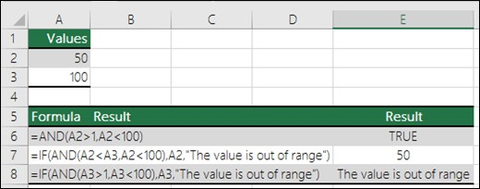
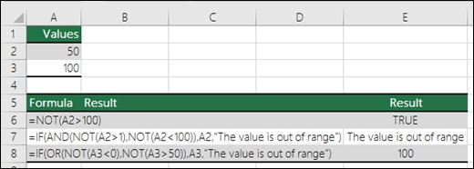
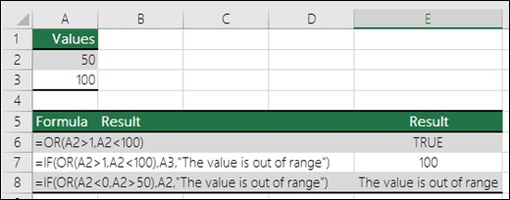
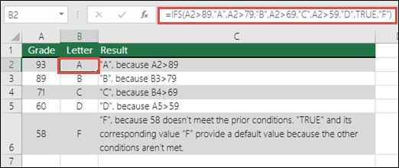
Logical Functions (AND, OR, NOT, XOR, IF, IFS…)
AND NOT
OR IFS

Slide 51
Data Cleaning with Text Functions
The data that you obtain from different sources many not be in a form ready for analysis.
Initially, you need to clean the data. Data cleaning includes removing unwanted characters from text. Next, you need to structure the data in the form you require for further analysis.
Text Fu | nctions
LEFT RIGHT MID TRIM LEN FIND SEARCH REPT CONCATENATE | REPLACE VALUE UPPER LOWER PROPER CHAR CLEAN SUBSTITUTE

Slide 52
Original Data | Function | Cleaned Data | Description
" john doe " | =PROPER(TRIM(A2)) | John Doe | Trim spaces and proper case
"HELLO WORLD" | =LOWER(A3) | hello world | Convert to lowercase
"apple, banana, apple" | =SUBSTITUTE(A4, "apple", "orange") | orange,banana,orange | Replace text
"Excel" | =LEFT(A5, 2) | Ex | First 2 characters
"Excel" | =RIGHT(A6, 3) | cel | Last 3 characters
"Excel" | =MID(A7, 2, 3) | xce | 3 characters starting from position 2
"John"&CHAR(10)&"Doe" | =CLEAN(A8) | JohnDoe | Remove non-printing characters
" 123 " | =VALUE(TRIM(A9)) | 123 | Convert text number to actual number

Slide 53
Function | Description | Example | Result
LEFT | Extracts characters from the start of a text string. | =LEFT("Excel", 2) | "Ex"
RIGHT | Extracts characters from the end of a text string. | =RIGHT("Excel", 3) | "cel"
MID | Extracts characters from middle, given start position and length. | =MID("Excel", 2, 3) | "xce"
TRIM | Removes all extra spaces, leaving only single spaces between words. | =TRIM(" Hello World ") | "Hello World"
LEN | Returns the number of characters (including spaces) in a string. | =LEN("Hello") | 5
FIND | Finds the position of a substring in a text (case-sensitive). | =FIND("c", "Excel") | 3
SEARCH | Like FIND, but not case-sensitive. | =SEARCH("C", "Excel") | 3
REPT | Repeats text a specific number of times. | =REPT("Hi", 3) | "HiHiHi"
CONCATENATE / & | Joins multiple text strings together. | =CONCATENATE("Good", " ", "Day")="Good" & " " & "Day" | "Good Day"
REPLACE | Replaces part of a string based on position. | =REPLACE("Excel", 2, 3, "123") | "E123l"
VALUE | Converts a text number into a numeric value. | =VALUE("123") | 123 (as number)
UPPER | Converts all text to uppercase. | =UPPER("excel") | "EXCEL"
LOWER | Converts all text to lowercase. | =LOWER("EXCEL") | "excel"
PROPER | Capitalizes the first letter of each word. | =PROPER("john doe") | "John Doe"
CHAR | Returns a character based on a ASCII code. | =CHAR(10) | Line break (used in formulas like CLEAN)
CLEAN | Removes non-printable characters (e.g. line breaks). | =CLEAN("Hello"&CHAR(10)&"World") | "HelloWorld"
SUBSTITUTE | Replaces specific text in a string. | =SUBSTITUTE("a,b,a", "a", "x") | "x,b,x"

Slide 54
There are various ways to extract first name, Middle name and Last name:
Using Excel Formulas(Text Function): Ex-A1=> Alice Claire Ben
=LEFT(A1, FIND(" ", A1)-1)
=MID(A1, FIND(" ", A1)+1, FIND(" ",A1,FIND(" ",A1)+1)-FIND(" ",A1)-1)
=RIGHT(A1, LEN(A1)- FIND(" ",A1,FIND(" ",A1)+1))
Using Text to Columns (Wizard Method):
The Text to Columns Wizard is a tool in Excel that splits the content of one column into multiple columns based on a delimiter (like space, comma, tab) or fixed width.

Slide 55
Text to Column Wizard in Excel
Steps to Use Text to Columns Wizard:
Select the Column
  Highlight the column that contains the text you want to split.
Go to Ribbon
  Click on Data tab → choose Text to Columns.
Choose the File Type
  Delimited → if data is separated by commas, spaces, tabs, semicolons, etc.
  Fixed Width → if data is aligned in columns with spaces at fixed positions.

Slide 56
Set Delimiters / Column Breaks
  If Delimited: check the delimiter(s) (comma, tab, space, semicolon, or custom).
  If Fixed Width: set vertical lines where you want to split.
Preview the Result
  Excel shows how data will be split in the preview box.
Choose Destination
  Select where the split data should appear (default replaces original column).
Finish
  Click Finish → your data is split into multiple columns.

Slide 57
Date Handling
The dates are referred to as serial numbers in Excel.
The dates in Excel are actually stored as numbers, and then formatted to display the date.
The DATE function returns the sequential serial number that represents a particular date.
Syntax: DATE(year,month,day)
By default, Microsoft Excel for Windows uses the 1900 date system, which means the first date is January 1, 1900.
Excel stores dates as sequential serial numbers so that they can be used in calculations. January 1, 1900 is serial number 1, and January 1, 2008 is serial number 39448 because it is 39,447 days after January 1, 1900. You will need to change the number format (Format Cells) in order to display a proper date.
The default date format for US dates is “m/d/yyyy” (1/27/2016).

Slide 58
Description | Formula in Excel | Example Result
Original Date | 12-Aug-2025 | 12-Aug-2025
Serial Number of Date | Format 12-Aug-2025 as Number | 45881
Date + 7 days | =A1+7 | 19-Aug-2025
Difference in Days (End - Start) | =A3-A1 | 7
Current Date | =TODAY() | 09-Aug-2025
Current Date & Time | =NOW() | 09-Aug-2025 10:30 AM
Day from Date | =DAY(A1) | 12
Month from Date | =MONTH(A1) | 8
Year from Date | =YEAR(A1) | 2025
Create Date using DATE() | =DATE(2025,8,12) | 12-Aug-2025
Years Between Two Dates | =DATEDIF("1-Jan-2020", "1-Jan-2025", "y") | 5
Months Between Two Dates | =DATEDIF("1-Jan-2020", "1-Jan-2025", "m") | 60
Days Between Two Dates | =DATEDIF("1-Jan-2020", "1-Jan-2025", "d") | 1826

Slide 59
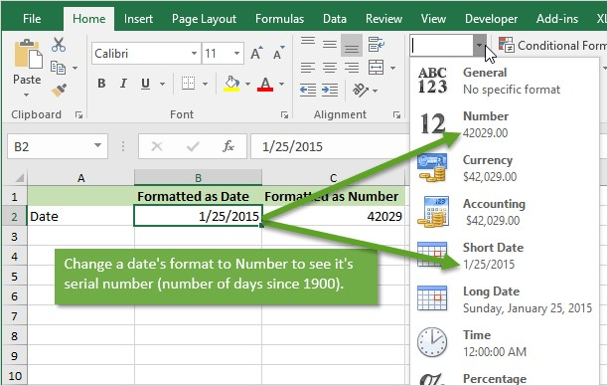
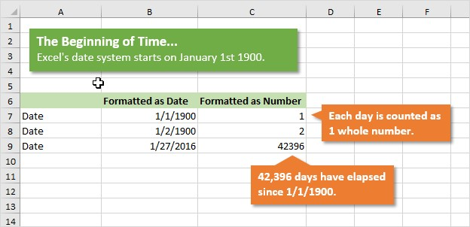
To display | Use this code | To display | Use this code
Months as 1–12 | m | Days as 1–31 | d
Months as 01–12 | mm | Days as 01–31 | dd
Months as Jan–Dec | mmm | Days as Sun–Sat | ddd
Months as January–December | mmmm | Days as Sunday– Saturday | dddd
Months as the first letter of the month | mmmmm | Years as 00–99 | yy
 |  | Years as 1900–9999 | yyyy

Slide 60
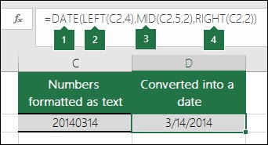
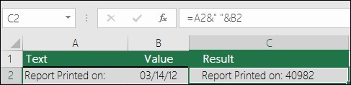
Date Conversions
You can use the DATE function to convert the information from text into dates. For example, in the following illustration, cell C2 contains a date that is in the format: YYYYMMDD. It is also formatted as text. , MID To convert it into a date, the DATE function was used in conjunction with the LEFT , and RIGHT functions.
Try to join text and a number without using the TEXT function. In this case, we’re using the ampersand (&) to concatenate a text string, a space (" "), and a value with =A2&" "&B2.

Slide 61
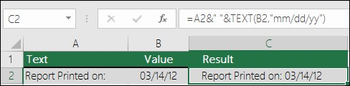
Excel removed the formatting from the date in cell B2. In the next example, you'll see how the TEXT function lets you apply the format you want.
Format cells feature can be used.
=TEXT(TODAY(),"MM/DD/YY") | Today’s date in MM/DD/YY format, like 03/14/12
=TEXT(TODAY(),"DDDD") | Today’s day of the week, like Monday

Slide 62
Time Handling
Excel’s time functions, which work with or return time serial numbers.
Excel’s time functions function description
HOUR(time) Extracts the hour component from the time given by time.
MINUTE(time) Extracts the minute component from the time given by time.
NOW Returns the serial number of the current date and time.
SECOND(time) Extracts the seconds component from the time given by time.
TIME(hour, minute, second) Returns the serial number of a time, in which hour is a number between 0 and 23, and minute and second are numbers between 0 and 59.
TIMEVALUE(time_text) Converts a time from text to a serial number.

Slide 63
For example, if it’s noon and today’s date is December 31, 2022, the NOW function returns the following serial number (although in the cell you see this displayed using the m/d/yyyy h:mm format):
44926.5 represents noon on December 31, 2022.
If you just want the time component of the serial number, subtract TODAY from NOW: NOW()- TODAY()
Time Serial Numbers in Excel
In Excel, time is stored as a decimal fraction of a 24-hour day.
0 → midnight (start of the day)
0.5 → noon (halfway through the day)
1 → midnight of the next day
Values range between 0 and 1.

Slide 64
Examples of Time Serial Numbers
For example, the following expression returns the time 2:45:30 p.m.:
TIME(14, 45, 30) Like the DATE function, TIME adjusts for wrong hour, minute, and second values.
For example, the following expression returns 3:00:30 p.m.: TIME(14, 60, 30) Here, TIME takes the extra minute and adds 1 to the hour value.
For example, the following expression returns the time serial number for the string 2:45:00 PM: TIMEVALUE("2:45:00 PM")
Serial Number | Time
0.25 | 6:00:00 AM
0.375 | 9:00:00 AM
0.70833 | 5:00:00 PM
0.99999 | 11:59:59 PM

Slide 65
For example, if it’s currently 3:15 PM, the following expression returns 15: MINUTE(NOW())
For example, the following expression returns 30: SECOND("2:45:30 PM")
Returning a time X hours, minutes, or seconds from now TIME(HOUR(NOW()) + 12, MINUTE(NOW()), SECOND(NOW())) this expression returns the time 12 hours from now.
Example: If current time = 09-Aug-2025 03:15:45 PM,
the formula will return → 10-Aug-2025 03:15:45 AM
(i.e., exactly 12 hours later).

Slide 66
Adding hours, minutes, and seconds
Operation | Expression | Example | Example Expression
Add n hours | n*(1/24) | Add 6 hours | NOW()+6*(1/24)
Add n minutes | n*(1/24/60) | Add 15 minutes | NOW()+15*(1/24/60)
Add n seconds | n*(1/24/60/60) | Add 30 seconds | NOW()+30*(1/24/60/60)
Note-Summing time values and Calculating the difference between two times (or two dates) can also be performed using Excel.

Slide 67
Function (DATE and TIME) | Description
DATE function | Returns the serial number of a particular date
DATEDIF function | Calculates the number of days, months, or years between two dates. This function is useful in formulas where you need to calculate an age.
DATEVALUE function | Converts a date in the form of text to a serial number
DAY function | Converts a serial number to a day of the month
DAYS function | Returns the number of days between two dates
DAYS360 function | Calculates the number of days between two dates based on a 360-day year
EDATE function | Returns the serial number of the date that is the indicated number of months before or after the start date
EOMONTH function | Returns the serial number of the last day of the month before or after a specified number of months

Slide 68
Function (DATE and TIME) | Description
HOUR function | Converts a serial number to an hour
ISOWEEKNUM function | Returns the number of the ISO week number of the year for a given date
MINUTE function | Converts a serial number to a minute
MONTH function | Converts a serial number to a month
NETWORKDAYS.INTL function | Returns the number of whole workdays between two dates using parameters to indicate which and how many days are weekend days
NOW function | Returns the serial number of the current date and time
SECOND function | Converts a serial number to a second
TIME function | Returns the serial number of a particular time
TIMEVALUE function | Converts a time in the form of text to a serial number

Slide 69
Function (DATE and TIME) | Description
TODAY function | Returns the serial number of today's date
WEEKDAY function | Converts a serial number to a day of the week
WEEKNUM function | Converts a serial number to a number representing where the week falls numerically with a year
WORKDAY function | Returns the serial number of the date before or after a specified number of workdays
WORKDAY.INTL function | Returns the serial number of the date before or after a specified number of workdays using parameters to indicate which and how many days are weekend days
YEAR function | Converts a serial number to a year
YEARFRAC function | Returns the year fraction representing the number of whole days between start_date and end_date

Slide 70
Function | Description | Example Formula | Example Output
DATE | Returns the serial number of a specific date | =DATE(2025,8,10) | 10-Aug-2025
DATEDIF | Days, months, or years between two dates | =DATEDIF("1-Jan-2020","10-Aug-2025","Y") | 5
DATEVALUE | Converts date text to serial number | =DATEVALUE("10-Aug-2025") | 45458
DAY | Day of the month from a date | =DAY("10-Aug-2025") | 10
DAYS | Number of days between two dates | =DAYS("10-Aug-2025","1-Jan-2025") | 221
DAYS360 | Days between two dates (360-day year) | =DAYS360("1-Jan-2025","10-Aug-2025") | 219
EDATE | Date before/after given months | =EDATE("10-Aug-2025",3) | 10-Nov-2025
EOMONTH | Last day of month before/after given months | =EOMONTH("10-Aug-2025",1) | 30-Sep-2025
HOUR | Extracts hour from time | =HOUR("14:45") | 14
ISOWEEKNUM | ISO week number of a date | =ISOWEEKNUM("10-Aug-2025") | 32
MINUTE | Extracts minute from time | =MINUTE("14:45") | 45
MONTH | Month number from a date | =MONTH("10-Aug-2025") | 8
NETWORKDAYS.INTL | Workdays between dates with custom weekends | =NETWORKDAYS.INTL("1-Aug-2025","10-Aug-2025",7) | 7
NOW | Current date and time | =NOW() | 10-Aug-2025 15:30 (example)
SECOND | Extracts seconds from time | =SECOND("14:45:30") | 30
TIME | Serial number of a specific time | =TIME(14,30,0) | 14:30
TIMEVALUE | Converts time text to serial number | =TIMEVALUE("2:30 PM") | 0.604167
TODAY | Current date only | =TODAY() | 10-Aug-2025
WEEKDAY | Day of week number | =WEEKDAY("10-Aug-2025") | 1 (Sunday)
WEEKNUM | Week number in year | =WEEKNUM("10-Aug-2025") | 32
WORKDAY | Date after workdays from a start date | =WORKDAY("1-Aug-2025",5) | 8-Aug-2025
WORKDAY.INTL | Date after workdays with custom weekends | =WORKDAY.INTL("1-Aug-2025",5,7) | 8-Aug-2025
YEAR | Year from a date | =YEAR("10-Aug-2025") | 2025
YEARFRAC | Year fraction between two dates | =YEARFRAC("1-Jan-2025","10-Aug-2025") | 0.60

Slide 71
Weekend Code | Weekend Days Off | Notes
1 | Saturday, Sunday | Default weekend
2 | Sunday, Monday | Common in some Middle East countries
3 | Monday, Tuesday | Rare schedule
4 | Tuesday, Wednesday | Rare schedule
5 | Wednesday, Thursday | Rare schedule
6 | Thursday, Friday | Common in some countries
7 | Friday, Saturday | Common in Middle East
11 | Sunday only | 1-day weekend
12 | Monday only | 1-day weekend
13 | Tuesday only | 1-day weekend
14 | Wednesday only | 1-day weekend
15 | Thursday only | 1-day weekend
16 | Friday only | 1-day weekend
17 | Saturday only | 1-day weekend

Slide 72
Conditional Formatting
The powerful conditional formatting features available in Excel enable you to highlight cells, create top and bottom rules, and apply three types of formatting: data bars, color scales, and icon sets.
You can apply conditional formatting based on the results of a formula. In particular, you can set up a logical formula as the conditional formatting criteria.
If that formula returns TRUE, Excel applies the formatting to the cells; if the formula returns FALSE, instead, Excel doesn’t apply the formatting. In most cases, you use an IF function, often combined with another logical function such as AND or OR.

Slide 73
Here are the basic steps to follow to set up formula-based conditional formatting:
Select the cells to which you want the conditional formatting applied.
Select Home > Conditional Formatting > New Rule. Excel displays the New Formatting Rule dialog box.
Select Use A Formula To Determine Which Cells To Format.
In the Format Values Where This Formula Is True range box, type your logical formula.
Select Format to open the Format Cells dialog box.
Use the Number, Font, Border, and Fill tabs to specify the formatting you want to apply and then select OK.
Select OK.

Slide 74
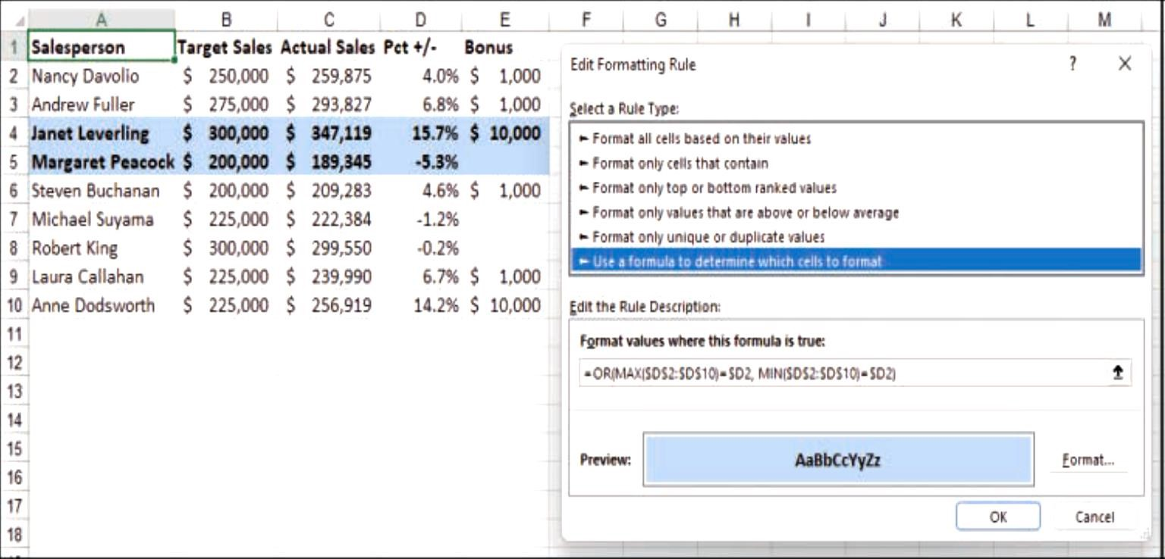
Example 1: The range of sales rep data is conditionally formatted using a logical formula.

Slide 75
First, you compare the range to the first value in the range;
Second, the cell address uses the mixed-reference format $D2, which tells Excel to keep the column (D) fixed, while varying the row number.
Next, you can use the MIN function to determine the minimum, so you create a similar comparison formula: =MIN($D$2:$D$10)=$D2
Finally, you want to check each cell in the column to see if it’s the maximum or the minimum, so you need to combine these expressions by using the OR function, like so: =OR(MAX($D$2:$D$10)=$D2, MIN($D$2:$D$10)=$D2)
Previous Figure shows a range of sales results (A2:E10) that are conditionally formatted using the preceding formula. This shows which reps had the maximum and minimum percentage differences between target sales and actual sales (column D).
Example 2-To search for the lowest nonzero number following formula can be set as rule: = A1=MIN(IF($A$1: $D$10<>0, $A$1:$D$10))

Slide 76
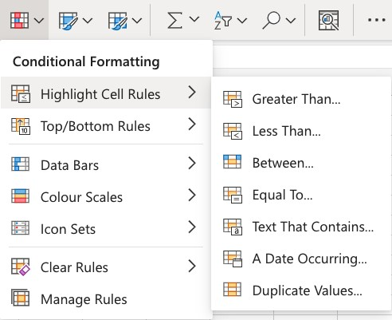
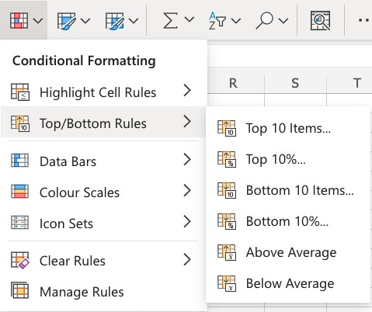
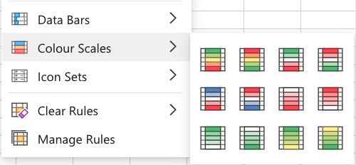
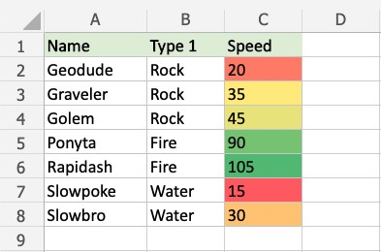
Conditional Formatting Options
Color
Scale
-
Rapidash
has
the
highest
Speed
value
(
105
and
)
Slowpoke
has
the
lowest
Speed
value
(
15
)
.

Slide 77
Sorting and Filtering
Sorting data is an integral part of data analysis. You might want to arrange a list of names in alphabetical order, compile a list of product inventory levels from highest to lowest, or order rows by colors or icons.
Sorting data helps you quickly visualize and understand your data better, organize and find the data that you want, and ultimately make more effective decisions.
The sorting tool allows you to sort by date, number, alphabetic order and more.
The filter tool gives you the ability to filter a column of data within a table to isolate the key components you need.
The filter feature applies a drop down menu to each column heading, allowing you to select specific choices to narrow a table.

Slide 78
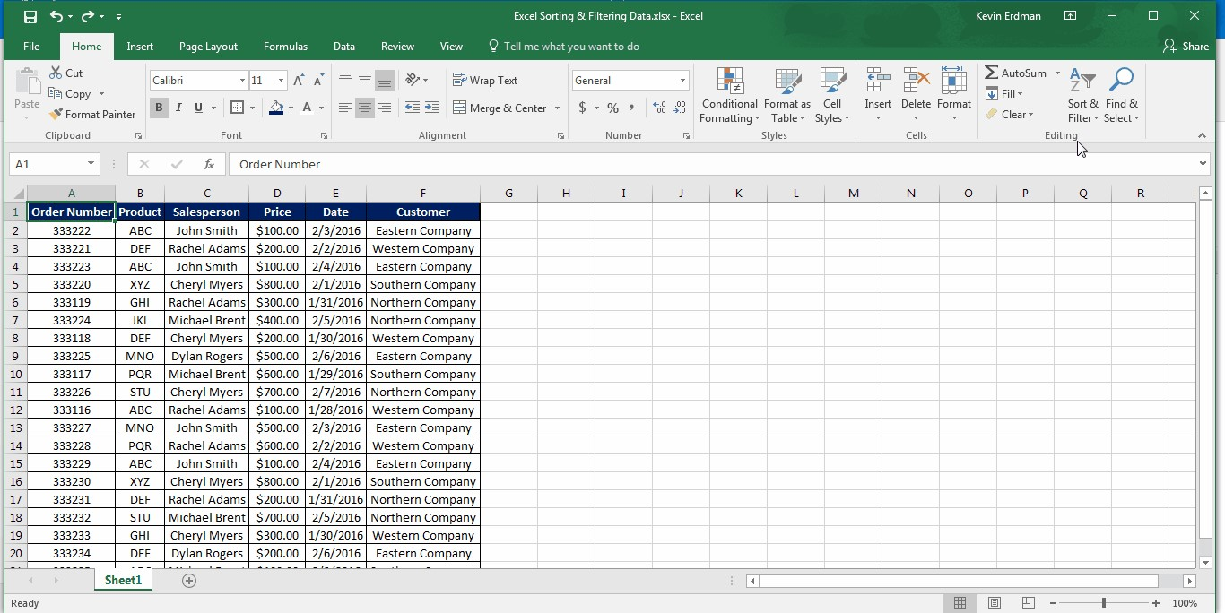
Sorting and Filtering Data With Excel

Slide 79
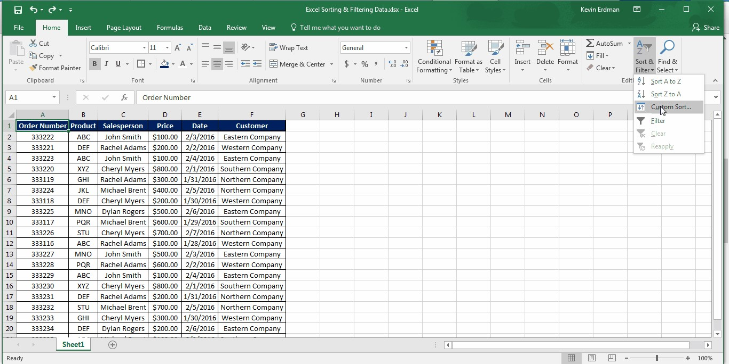
Sorting with levels

Slide 80
Subtotals with Ranges
If you have a list of data that you want to group and summarize, you can use Excel Subtotal and Outline to display summary rows or columns.
You can create an Outline of up to eight levels, one for each group. Outer Levels are represented by Lower Numbers and Inner Levels by Higher Numbers. Each inner level displays detailed data for the preceding outer level.
Subtotal and Outline is the quickest way to analyze a range of data. Note that Subtotal and Outline can be used only on a range and not on a table. Data sorting is essential.

Slide 81
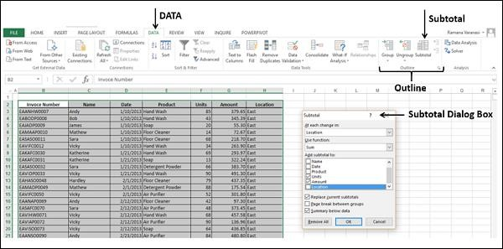

Slide 82
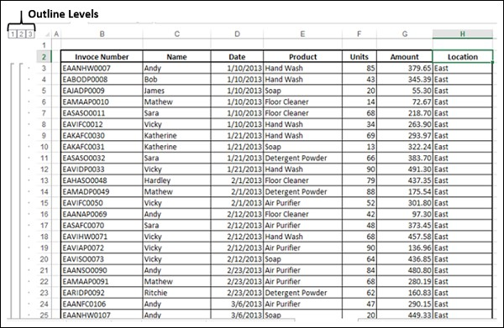

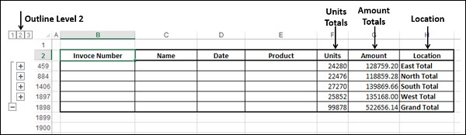
The data is grouped with three levels and the subtotals are calculated location wise.

Slide 83
THANK YOU

